Slide 1

INC300
Week 9
Social Media and Civic Engagement
Amanda Piche, PhD Candidate
July 19th, 2018

Slide 2
Today’s Agenda
Check-in
Lecture

Slide 3
Lecture 9: Social Media and Civic Engagement
Learning Outcomes:
Describe the intersection of media technologies with activist movements, as well as specific forms of participatory culture that have transpired since the advent of social media
Discuss the role of social media in activist movements, and the re-configuring of social media like Facebook, Twitter, and Youtube for activist use

Slide 4
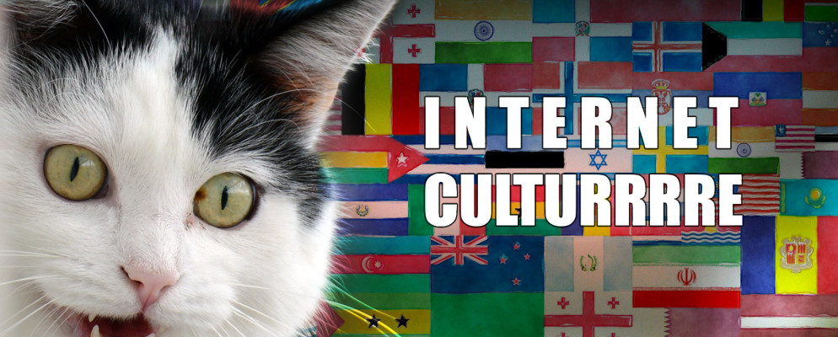
Week 8 Recap
Describe the connections between dialogic communication and participatory culture.
Use the concepts of homophily and affinity groups to explain the formation of communities via social media and explain how LOLCats are an example of such.
Describe how the making and sharing of Internet memes can lead to connection, interaction and participation in particular communities.
Describe what is involved in making content ‘go viral'

Slide 5
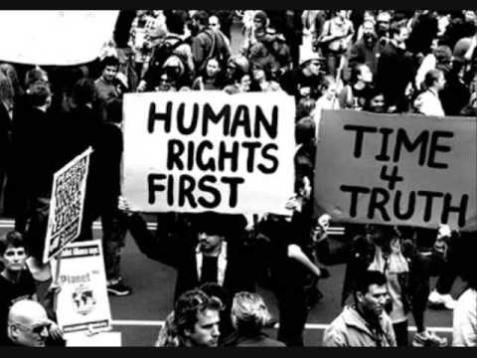
Introduction
The Internet and the mobile phone are arguably the two most revolutionary advances in our lifetimes. These advances have also given way to a range of social and digital media platforms (e.g. Twitter, Facebook, etc.) that broaden people’s networks and that allow for immediate information sharing.
These social and digital media platforms have allowed political activists and social movements to more quickly and widely spread information, publicize injustice, and challenge systems of power.
Yet social media also poses challenges with regard to creating true social change and the extent to which people’s actions and interests are surveilled and used to maximize business profits.

Slide 6
Introduction
Questions to consider this lecture include:
  Does the ease with which the Internet allows us to connect, interact and participate in issues that are important to our local and global communities motivate us to action and support causes?
  Are we becoming more complacent as it is so easy to like or show support for a cause just by clicking?
  What are some of the global, political and social consequences of the ease with which anyone can become an internet activist?

Slide 7
Defining Activism
Activism: The policy or action of using vigorous campaigning to bring about political or social change.
  Forms of activism range from writing letters to newspapers or to politicians, political campaigning, economic activism such as boycotts or preferentially patronizing businesses, rallies, street marches, strikes, sit-ins, and hunger strikes
Digital activism refers to online participation in cause-related movements. In such campaigns, digital activists leverage networked technologies -- YouTube, Twitter, Facebook, blogs, SMS text messaging -- for social and political change campaigns.
As grassroots organizers take advantage of their digital tool belts, it is revolutionizing how activists rally. Via digital means, socially aware people can connect, and create change in a space that is free and global -- the World Wide Web. In addition, individuals can organize large scale events, to create awareness and engage others for their cause, at virtually no cost.
Notes:
http://rabble.ca/toolkit/rabblepedia/digital-activism

Slide 8
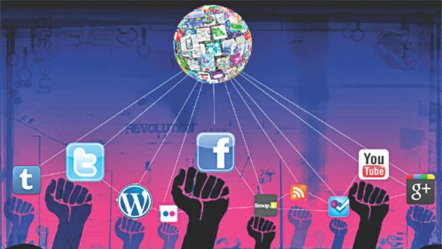
Ultimate Goals of Online Activism
Listening and learning
Taking a stand
Influence decision-makers
Educate family, friends, strangers
Build community
Mobilize
Shape history
Notes:
https://www.slideshare.net/NataschaThomson/social-media-for-activism

Slide 9
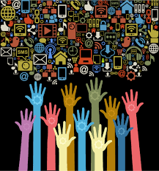
Why is Social Media a tool for activism?
It’s a place where many spend a lot of time
It is efficient
It is (often) public
It spreads the message
Notes:
https://www.slideshare.net/NataschaThomson/social-media-for-activism

Slide 10
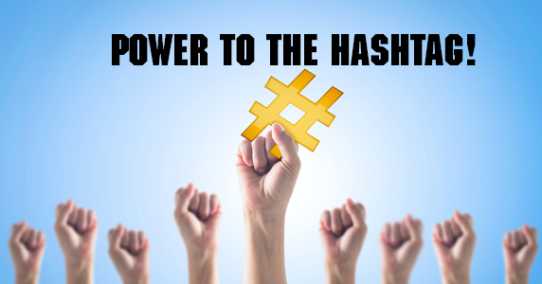
How to use Social Media as a tool for activism?
Connect directly with politicians
Organize events
Inform
Engage
Notes:
https://www.slideshare.net/NataschaThomson/social-media-for-activism

Slide 11
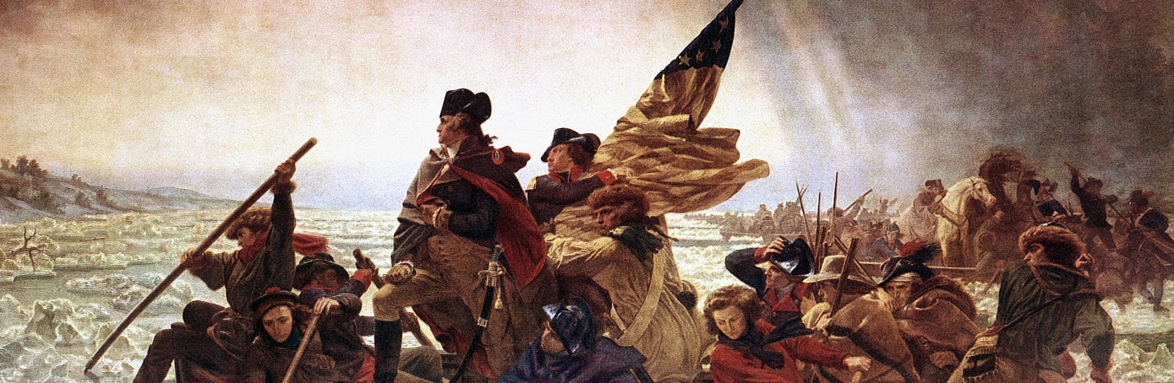
Communication and Social Movements
Ex. the American Revolution relied on:
  Printing Press
  Federalist Papers - PR campaign of letters to newspapers
  Common Sense – Thomas Paine

Slide 12
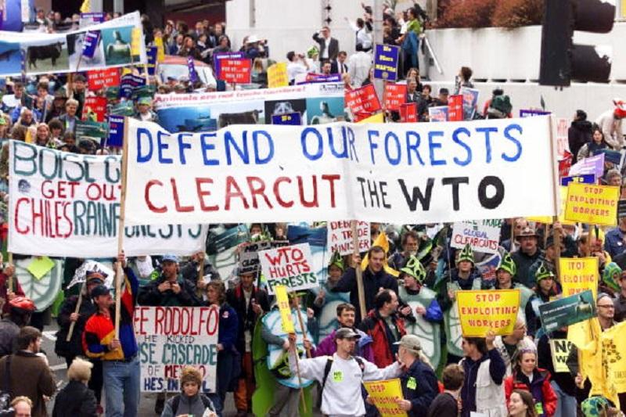
Seattle WTO Protests of 1999
Seattle WTO protests of 1999, a series of marches, direct actions, and protests carried out from November 28 through December 3, 1999, that disrupted the World Trade Organization (WTO) Ministerial Conference in Seattle, Washington.
The Seattle WTO protests were some of the first major international mobilizations to be coordinated via the Internet (through e-mail, message boards). The protests were reported online with streaming audio and video clips by the Seattle Independent Media Center. While 400,000 people took part in a virtual sit-in of the WTO Web site organized by the Electrohippies Collective, more than 40,000 protesters (some estimates were as high as 60,000) were in Seattle to oppose everything from specific WTO policies to free trade and the human rights failures of globalization. Throughout the week, NGOs also sponsored debates, lectures, and teach-ins.
Notes:
Source: https://www.britannica.com/event/Seattle-WTO-protests-of-1999

Slide 13
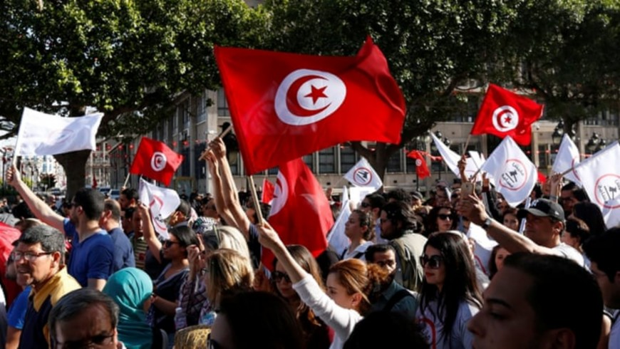
The Tunisian Revolution (2011)
Demonstrations were caused by high unemployment, food inflation, corruption, a lack of political freedoms like freedom of speech and poor living conditions.
Tunisians were using Twitter for logistics, from warning of sniper locations, to calling for blood donation at hospitals, to organizing protests.
“[In Tunisia], there was already a very strong online anti-censorship movement prior to this happening. You already had an Internet elite who were connected to one another, and they were able to leverage those ties to get information out. You had people who were genuinely linking up with each other through social networks to figure out what’s going on.”
“Thousands of “citizen-journalists” uploaded photos, videos, texts, appeals and more to social media sites, which were then re-broadcast by Al-Jazeera. Social media enabled the revolting citizens Tunisia to bypass censored state media and talk to each other.”
Youssef Cherif, a Tunisian political analyst, says social-media sites like Facebook and Twitter empowered young people to express their opinion.
"However, in 2011, when more than a million Tunisians were on Facebook, [watching] the videos of police brutality, videos of people daring to confront the security forces, people said, 'Wow, this is really happening'."
Notes:
https://www.huffingtonpost.com/colin-delany/how-social-media-accelera_b_821497.html
Link in photo: https://www.youtube.com/watch?v=C9KIWD4Ru_0

Slide 14
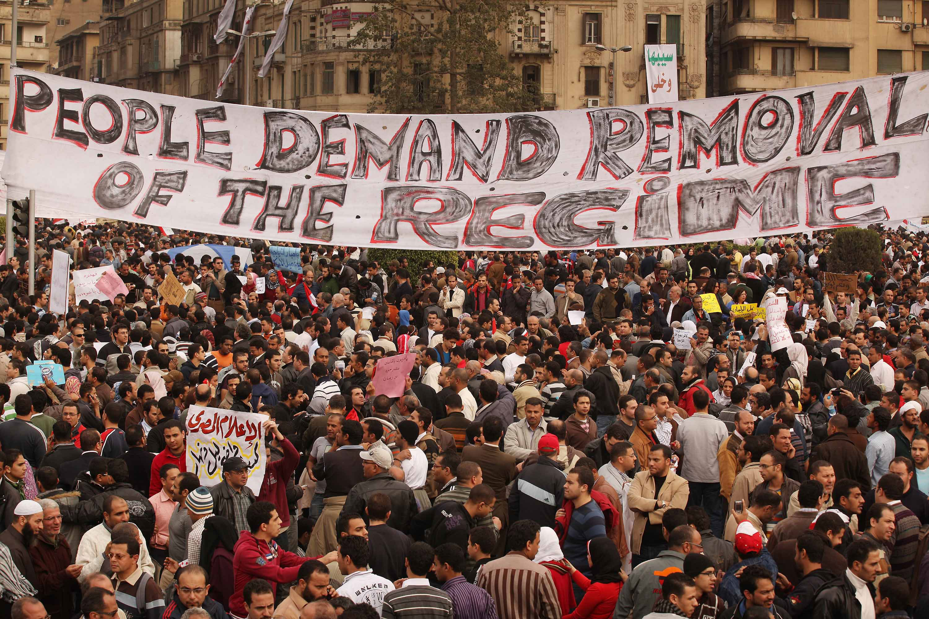
The Egyptian Revolution
The 2011 revolution in Egypt started with marches, demonstrations and civil resistance on January 25.
Protesters were inspired by the successful uprising in Tunisia, where demonstrators succeeded in bringing down the government.
People came on to the streets demanding the overthrow of Egyptian President Hosni Mubarak. They complained of poverty, unemployment, corruption and autocratic governance of the president who had ruled the country for 30 years.
After 18 days of protest, Vice President Omar Suleiman announced on February 11 that Mubarak would resign as president, handing over power to the Supreme Council of the Armed Forces.
Reflecting upon the activities of protestors in the ejection of President Mubarak from power, on March 18th, 2011, Fawaz Rashed (@FawazRashed) sent the following message from his Twitter account: “We use Facebook to schedule the protests, Twitter to coordinate, and YouTube to tell the world.”

Slide 15
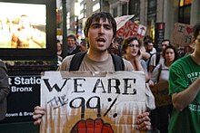
Occupy Wall Street (2011)
Occupy Wall Street was a protest movement that began on September 17, 2011, in Zuccotti Park, located in New York City's Wall Street financial district. It received global attention and spawning a surge in the movement against economic inequality worldwide
Notes:
Link in photo.

Slide 16
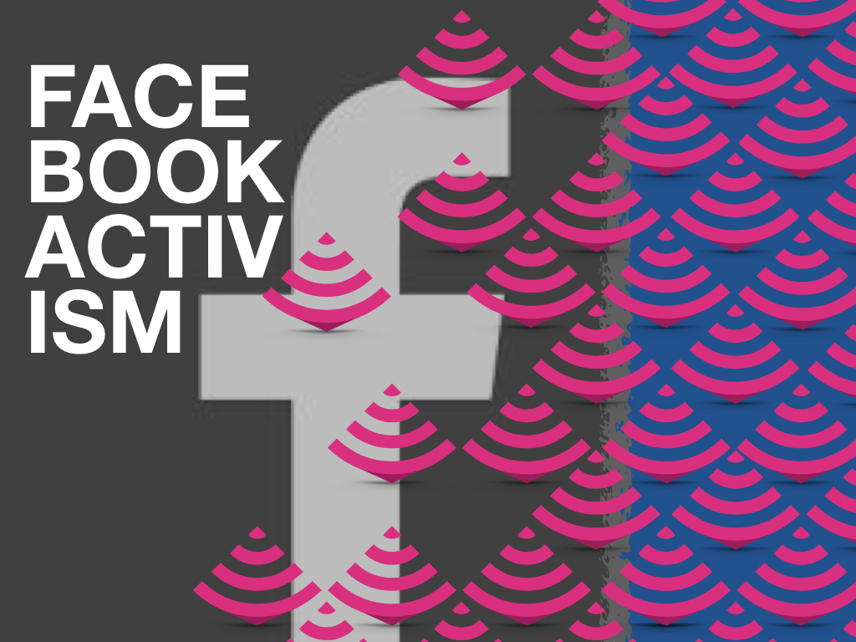
Facebook as a tool for activism
Follow people in your target audience
  Politicians, activists
Post on their walls and comment on their posts
Share and like relevant posts
Join existing groups & events
Start your own group & event
Use Facebook Live to capture events and broadcast them in real-time
Notes:
Link in photo.

Slide 17
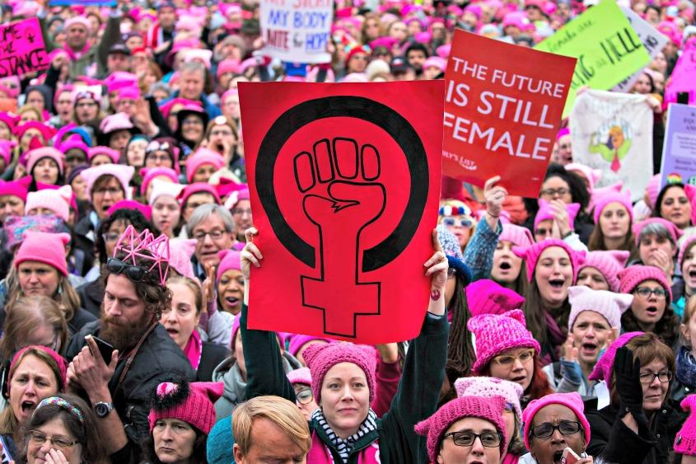
Facebook as a tool for activism
Ex. Women’s March 2017
According to a study from researchers at the University of Maryland, almost 70% of people who attended the D.C. march heard about it on Facebook. Meanwhile, 61% from friends and family.
"The take-home message here is clearly that Facebook matters more than friends and family to mobilization," Dr. Dana R. Fisher, sociology professor and leader of the study
Just 13% heard out about the march through Twitter
Protest organizers collaborated through groups and events on Facebook, and photos of the protests went viral across social media.
Notes:
https://money.cnn.com/2017/02/17/technology/womens-march-facebook-activism/index.html

Slide 18
Facebook as a tool for activism
As Facebook becomes an important tool in coordinating protests, some people are wary of using it to let friends know they're attending. A recent study from the ACLU found that police departments use social media to monitor protests, and although Twitter and Facebook cut off access to one tool, it does raise privacy concerns.
However, Facebook is crucial to mobilizing a large audience, according to Eva Galperin, director of cybersecurity at the Electronic Frontier Foundation. More than one billion people use Facebook -- it's the best way to connect to big groups and their friends.
"There are definitely elements of planning activism that you want to keep off Facebook, especially if you're planning some sort of civil disobedience," Galperin told CNNTech. "[But] in getting the word out, it is unrealistic to tell people not to use Facebook for this purpose."
Notes:
https://money.cnn.com/2017/02/17/technology/womens-march-facebook-activism/index.html

Slide 19
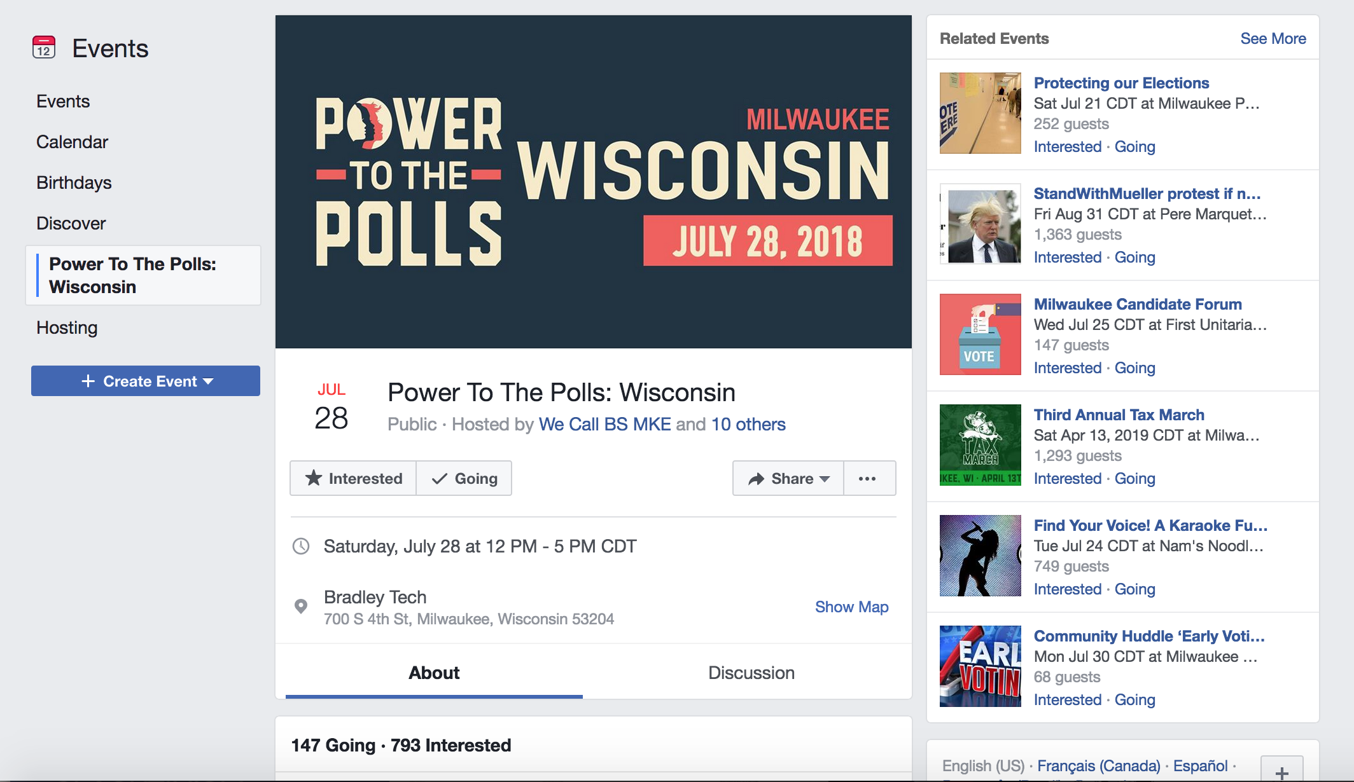

Slide 20
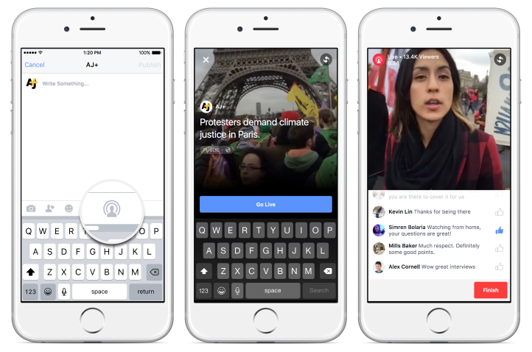
Facebook as a tool for activism
The capability to live broadcast on Facebook since 2015/2016 has become a means to document events and direct attention to them
Live streaming more accessible to people who are accidental eyewitnesses or not activists, because they grow accustomed to using it in noncrisis settings and then have the tool available to them in a crisis. That said, this opens them up to a range of risks to themselves and others—of exposure, of retaliation, of unexpectedly being placed in a live spotlight—that platforms need to do a better job of supporting and responding to.
Unlike in the US, live streaming isn’t always protected by the law. And, no matter where in the world people are filming, doing so often puts the streamer’s life at risk.
Notes:
https://money.cnn.com/2016/07/07/media/facebook-live-streaming-police-shooting/index.html
https://www.wired.com/2016/11/livestreaming-transforming-activism/

Slide 21
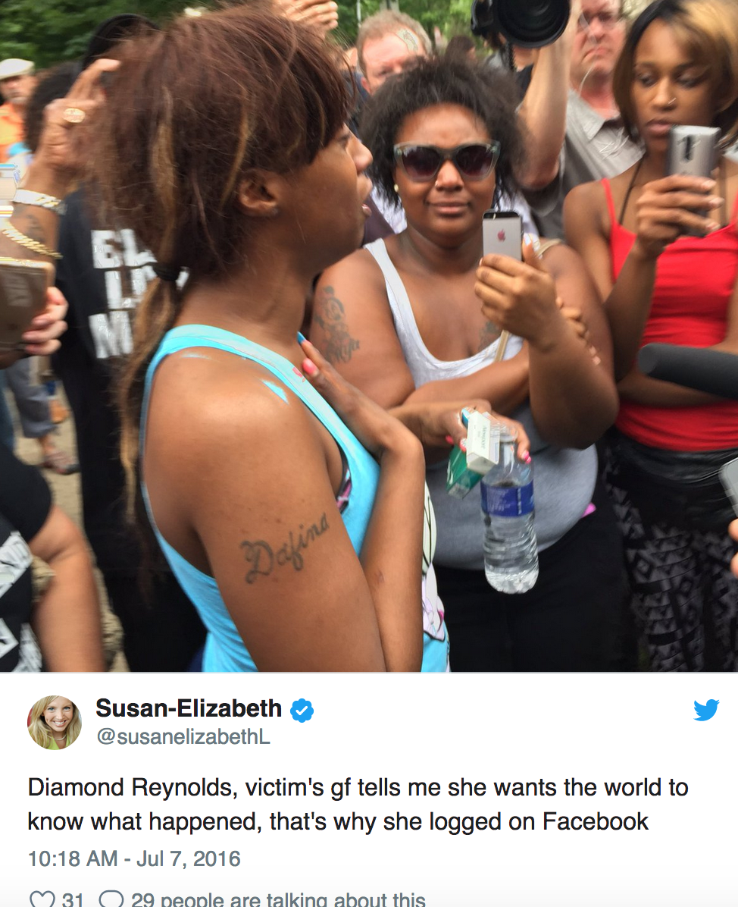
Philandro Castile case
On July 6, 2016, Philando Castile, a 32-year-old black American, was pulled over while driving in Falcon Heights, Minnesota, and killed by Jeronimo Yanez, a St. Anthony, Minnesota police officer.
The shooting achieved a high profile from a live-streamed video on Facebook made by Reynolds in the immediate aftermath of the shooting. In the video, she is talking with Yanez while a mortally injured Castile lies slumped over
Reynolds said she "wanted everyone in the world to know" what had happened, specifically citing police mistreatment.
Facebook Live automatically records live streams and lets people re-watch them later. Reynolds' video was spotted quickly and shared by Black Lives Matter activists.
By the end of the night, other live streams showed mourners and protesters gathering outside the Minnesota governor's mansion.
By noon the next day, according to Facebook's measurement tool, the video has been viewed 3.2 million times on Reynolds' page. And it has been seen countless millions more times on television.
Notes:
https://money.cnn.com/2016/07/07/media/facebook-live-streaming-police-shooting/index.html
https://www.wired.com/2016/11/livestreaming-transforming-activism/

Slide 22
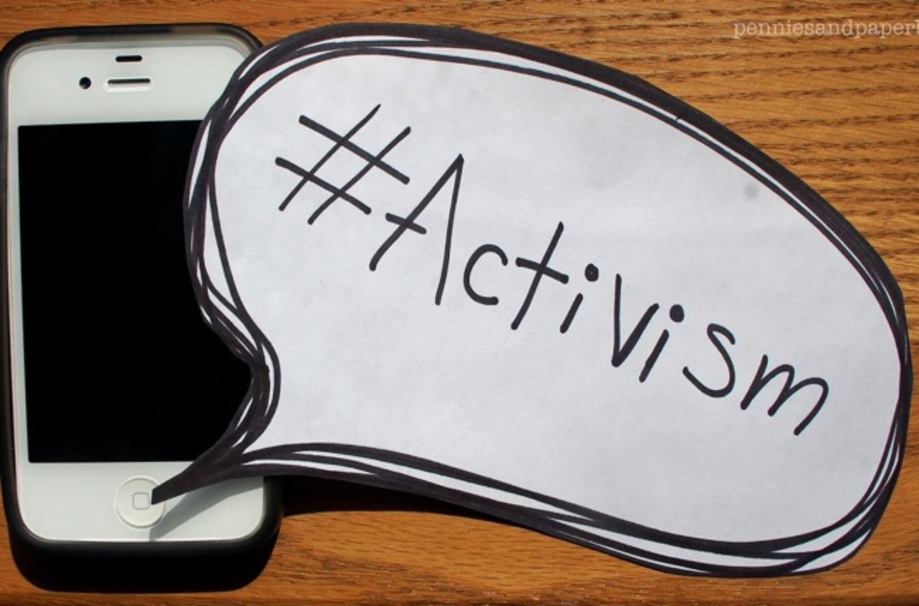
Twitter Activism/Hashtag Activism
Hashtag activism is a term coined by media outlets which refers to the use of Twitter's hashtags for Internet activism. The term can also be used to refer to the act of showing support for a cause through a like, share, etc. on any social media platform, such as Facebook, Google+, or Twitter. The point of hashtag activism is arguably to share certain issues with one's friends and followers in the hopes that they will also share the same information. This leads to a widespread discussion and allows for change to occur.
Notes:
https://www.huffingtonpost.com/sabina-khanibarra/the-case-for-social-media_b_6149974.html/

Slide 23
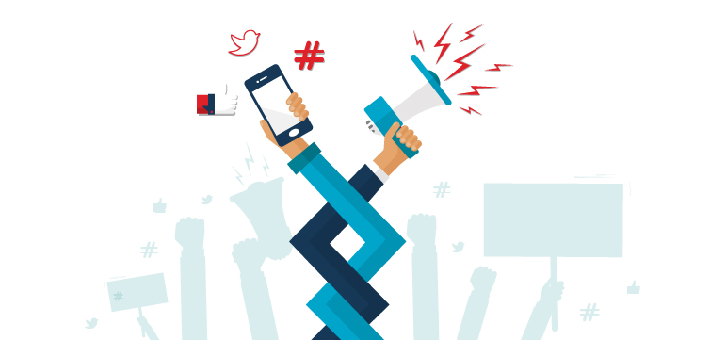
Twitter as a tool for activism
Note that hashtags help to organize conversations – useful to find and contribute to discussions about a variety of topics
Follow people in your target audience
Engage: Tweet directly to people, reply to their posts, retweet posts, mention people in Tweets, like Tweets
Follow and participate in discussions on hashtags
Livestream events (from Twitter app)
Notes:
https://www.huffingtonpost.com/sabina-khanibarra/the-case-for-social-media_b_6149974.html/

Slide 24
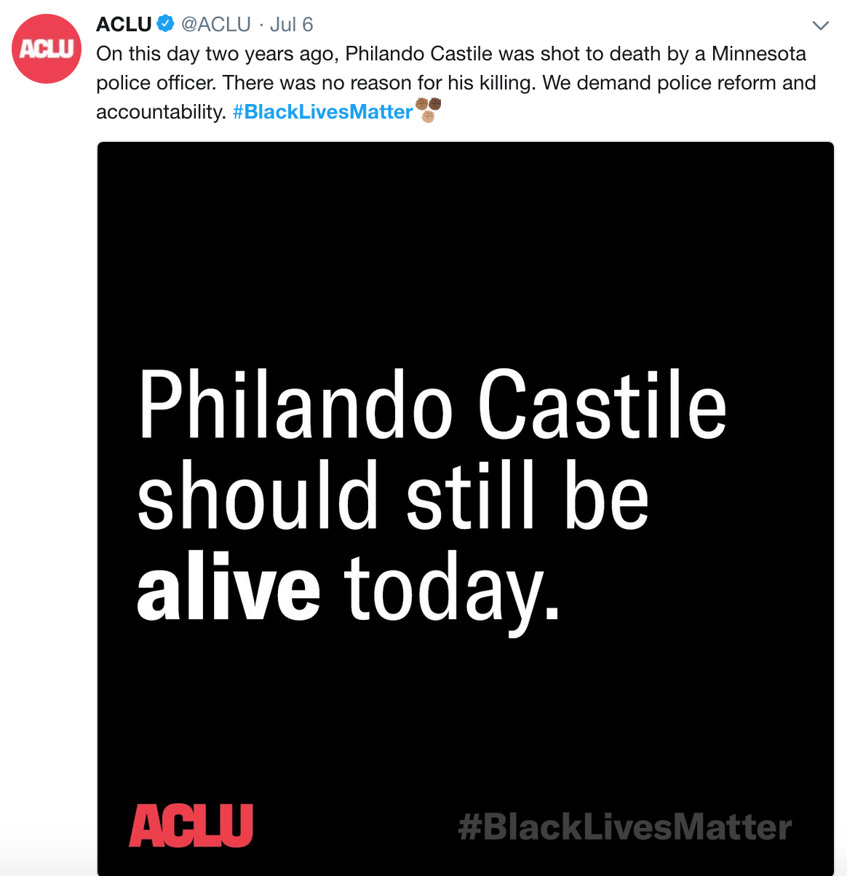
Ex. #BlackLivesMatter
The Black Lives Matter movement calls for an end to police brutality and the killings of African-Americans in the U.S. The #BlackLivesMatter hashtag was first started by Alicia Garza, Patrisse Cullors, and Opal Tometi as a response to the trial and later acquittal of George Zimmerman who shot and killed 17-year-old Trayvon Martin. The hashtag saw a revival in 2014, after the shooting of Michael Brown in Ferguson, Missouri, and after a grand jury did not indict police officer Daniel Pantaleo in the death of Eric Garner.
Notes:
https://www.huffingtonpost.com/sabina-khanibarra/the-case-for-social-media_b_6149974.html/

Slide 25
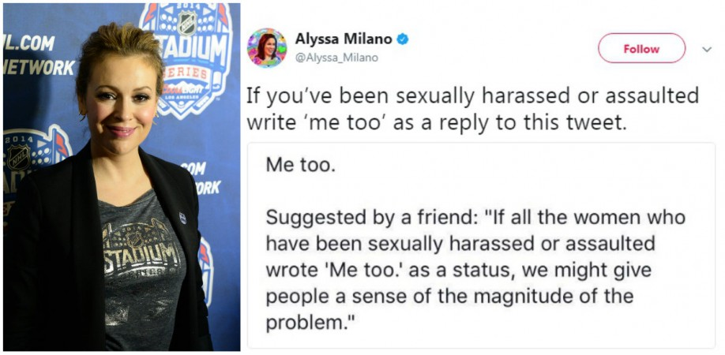
Ex. #MeToo
The Me Too movement (or "#MeToo", with local alternatives in other languages) is an international movement against sexual harassment and assault. #MeToo spread virally in October 2017 as a hashtag used on social media to help demonstrate the widespread prevalence of sexual assault and harassment, especially in the workplace. It followed soon after the public revelations of sexual misconduct allegations against Harvey Weinstein.
Tarana Burke, a social activist and community organizer, began using the phrase "Me Too" in 2006, and the phrase was popularized by Alyssa Milano in 2017 when she encouraged women to tweet about it and "give people a sense of the magnitude of the problem". The response on Twitter included high-profile posts from several celebrities including Gwyneth Paltrow, Ashley Judd, Jennifer Lawrence, and Uma Thurman.
Notes:
https://www.huffingtonpost.com/sabina-khanibarra/the-case-for-social-media_b_6149974.html/

Slide 26
YouTube as an activist tool
YouTube can be a tool to store and share imagery captured during events in the hopes to garner attention.
Additionally, there are many great organizations that are using YouTube to raise awareness, fundraise and educate.
Nonprofits have amazing stories to tell, this is one reason why they fare very well in a world of social media. They are authentic and this very often comes through clearly in their words, images and videos.
Notes:
https://www.forbes.com/sites/rahimkanani/2012/06/04/why-youtube-is-the-ultimate-platform-for-global-social-change/#44e65e425501

Slide 27
Ex. It Gets Better Project
In September 2010, syndicated columnist and author Dan Savage created a YouTube video with his partner Terry Miller to inspire hope for young people facing harassment. In response to a number of students taking their own lives after being bullied in school, they wanted to create a personal way for supporters everywhere to tell LGBT youth that, yes, it does indeed get better.
They welcomed response videos and the project now includes more than 50,000 submissions, with more than 50 million views, from people of all sexual orientations, including many celebrities, from Obama, to Anne Hathaway to the cast of True Blood. They engaged people in a way that allowed their voices to be heard, but without just focusing on donations.
By engaging people, they also turned video views into action. Since the launch of It Gets Better, calls to the Trevor Project suicide hotline have increased over 50%. By the end of 2010, the It Gets Better Project had raised over $100,000 from 2,500+ grassroots contributors to help LGBT youth.
Notes:
https://www.forbes.com/sites/rahimkanani/2012/06/04/why-youtube-is-the-ultimate-platform-for-global-social-change/#44e65e425501

Slide 28
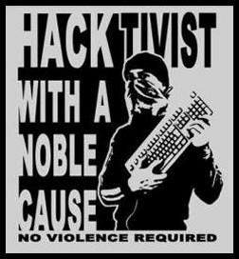
Hacktivism
In Internet activism, hacktivism or hactivism (a portmanteau of hack and activism) is the subversive use of computers and computer networks to promote a political agenda or a social change. With roots in hacker culture and hacker ethics, its ends are often related to the free speech, human rights, or freedom of information movements.
Self-proclaimed "Hactivists" often work anonymously, sometimes operating in groups while other times operating as a lone-wolf with several cyber-personas all corresponding to one activist within the cyberactivism umbrella that has been gaining public interest and power in pop-culture.

Slide 29
Hacktivism – Forms and Methods
Code: Software and websites can achieve political purposes. WikiLeaks is an example of a politically motivated website: it seeks to "keep governments open".
Website Mirroring: is used as a circumvention tool to bypass censorship blocks on websites. It is a technique that copies the content of a censored website and posts it to other domains and subdomains that are not censored.
Anonymous blogging: a method of speaking out to a wide audience about human rights issues, government oppression, etc. that utilizes various web tools such as free and/or disposable email accounts, IP masking, and blogging software to preserve a high level of anonymity.
Leaking: Information leakage from an insider source who acts in the interest of the public to reveal sensitive and otherwise protected information about a given organization that implicates them in wrongdoing or malicious practices.
Doxing: The practice in which private and/or confidential documents and records are hacked into and made public. Hactivists view this as a form of assured transparency, experts claim it is harassment.
Denial-of-Service attacks: These attacks use large arrays of personal and public computers that hackers take control of via malware executable files usually transmitted through email attachments or website links. After taking control, these computers act like a herd of zombies, redirecting their network traffic to one website, with the intention of overloading servers and taking a website offline.

Slide 30

WikiLeaks

Slide 31

Ex. Anonymous
Anonymous is a decentralized international hacktivist group that is widely known for crashing Web servers, website defacement and leaking hacked private information of several governments, government institutions & government agencies, corporations, and the Church of Scientology.
While there are no specific goals, there is an overarching desire to combat censorship, promote freedom of speech, and counter government control that sparks people in the so-called collective into action.
Ex. In the wake of the fatal police shooting of unarmed African-American Michael Brown in Ferguson, Missouri, "Operation Ferguson"—a hacktivist organization that claimed to be associated with Anonymous—organized cyberprotests against police, setting up a website and a Twitter account to do so. The group promised that if any protesters were harassed or harmed, they would attack the city's servers and computers, taking them offline
Notes:
Link in photo: https://youtu.be/ylZcsv86Uiw

Slide 32
The Internet and Democracy
There are two competing perspectives of the role of the Internet in democracy:
  Strengths: digital communication technologies provide accessible networks and tools that encourage the spread of information and discussion with less mediation, making discussion more autonomous and authentic to actual concerns, and, in the process, reinvigorating the public sphere; additionally, the horizontality of these networks encourage community-mindedness, for they come to motivate people to action.

Slide 33
The Internet and Democracy
There are two competing perspectives of the role of the Internet in democracy:
  Limitations: fragmentation, the internet’s structure, slacktivism, and the digital divide.

Slide 34

Strength: Accessibility
Note: online communication technologies do not create change in and of themselves – they do not produce public spheres or create bonded communities inspired to take political action, nor do they guarantee their creation and sustenance; rather, online platforms are tools that, when utilized appropriately by individuals, guide the development of these phenomenon.
Those with access are capable of exercising agency in deciding to use these platforms in order to engage politically, being able to educate themselves on and debate political issues and to mobilize around social causes.
Notes:
Benkler, Yochai. The Wealth of Networks: How Social Production Transforms Markets and Freedom. New Haven: Yale University Press, 2006.

Slide 35
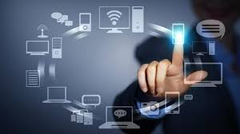
Strength: Accessibility
According to Yochai Benkler (2006), new structures of communication associated with digital technologies includes tools for autonomous interaction that can be used for civic engagement that is distinct from commercialized and governmental ties.
The tools for information production and communication are in the possession of the masses (i.e. personal computers and network connection) (4); these computers provide access to networks that feature webpages that are designed for user interactivity, prompting for user-generated content, the dissemination of information, and arenas for discussion. In light of this, nonmarket collaborations motivate individuals to work together, resulting in a flourishing nonmarket sector of information, knowledge, and cultural production (Ibid)
“Diversity of ways of organizing information production and use opens a range of possibilities for pursuing the core political values of liberal societies – individual freedom, a more genuinely participatory political system, critical culture, and social justice.” (7-8).
Notes:
Benkler, Yochai. The Wealth of Networks: How Social Production Transforms Markets and Freedom. New Haven: Yale University Press, 2006.

Slide 36

Strength: Accessibility
The networked information economy creates a shift to a more participatory environment that enables individuals to be more involved in the creation and dissemination of information
“The current diversification of communication channels is politically important because it expands the range of voices that can be heard: though some voices command greater prominence than others, no one voice speaks with unquestioned authority. The new media operate with different principles than the broadcast media that dominated American politics for so long: participation, reciprocity, and peer-to-peer rather than one-to-many communication. Given such principles, we should anticipate that digital democracy will be decentralized, unevenly dispersed, profoundly contradictory, and slow to emerge” (Jenkins et al, 208-209)
Notes:
Jenkins, Henry. Convergence Culture: Where old and new media collide. NYU press, 2006.

Slide 37
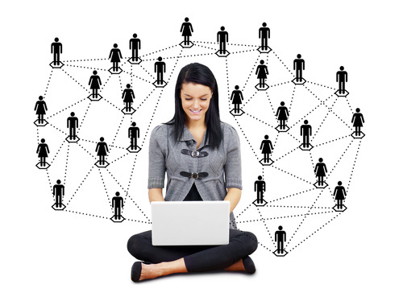
Strength: Encourages Community-Mindedness
To Manuel Castells (2012), as part of ongoing social dynamics, individuals can use communication tools to spread ideas about resistance that take root in the minds of individuals, reframing their intentions, values and behaviors; nowadays, this happens by way of current technologies that encourage mass self-communication (communication shaped by the self), that are characterized by multimodal, interactive, self-created, self-combined content (257).
Notes:
Castells, Manuel. Networks of Outrage and Hope: Social Movements in the Internet Age. Cambridge: Polity Press, 2012.

Slide 38
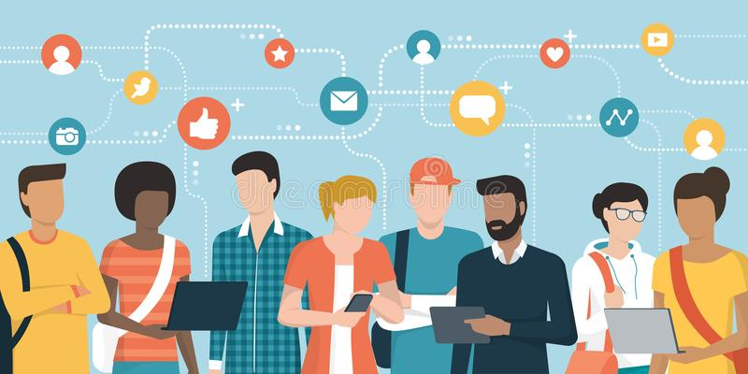
Strength: Encourages Community-Mindedness
Through large-scale, horizontal means of communication that exist autonomously, individuals - reacting to societal conditions with fear - find comfort in finding groups of people online who feel like they do; being witness to and engaging in discussion triggers feelings of hope as individuals define their concerns and map out actions to demonstrate resistance (Castells, 247). This sense of togetherness can be transferred into the offline, encouraging the physical occupation of space (Castells, 250).
Notes:
Castells, Manuel. Networks of Outrage and Hope: Social Movements in the Internet Age. Cambridge: Polity Press, 2012.

Slide 39
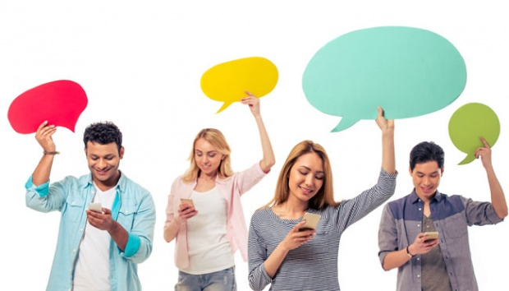
Strength: Encourages Community-Mindedness
Similarly, for Paolo Gerbaudo (2012), the choreography of individuals through digital channels is crucial towards inciting motivation to participate. Digital tools are utilized by social media administrators to instigate acts of ‘choreographing’: that is, “…the mediated ‘scene-setting’ and ‘scripting’ of people’s physical assembling into public space” (40).
Influential social media administrators may become soft leaders or choreographers, involved in setting the scene and constructing an emotional space within which collective action can unfold (Gerbaudo, 2012, 5). To speak to this more, the choreography of assembly is made visible by means of social media, directing individuals towards specific events, offering guidance for how to participate, and constructing an emotional narration that motivates engagement both on and offline (12, 162).
Notes:
Gerbaudo, Paolo. Tweets and the Streets: Social Media and Contemporary Activism. Pluto Press, 2012.

Slide 40
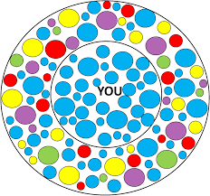
Limitation: Fragmentation
Cass Sunstein explores fragmentation in Republic 2.0
Given that the internet encourages the presence of an abundance of means to publish content, individuals may come to fixate on their groups’ interests (77).
Public culture becomes threatened should these activities become ubiquitous, as groups would establish little contact with each other, thereby diminishing their capacity to understand each other and build alliances.
Matters become more complicated when we consider that these ‘information cocoons’ encourage the screening of content that deviates from popular group-thought (217).
Without lack of confrontation with the information or arguments that may challenge existing worldviews, citizenship and democracy are debilitated; a well-functioning democracy is dependent on people being exposed to information they would not necessarily choose consume, and to have a change of common experiences that diversifies their own opinion (5, 12-13).

Slide 41
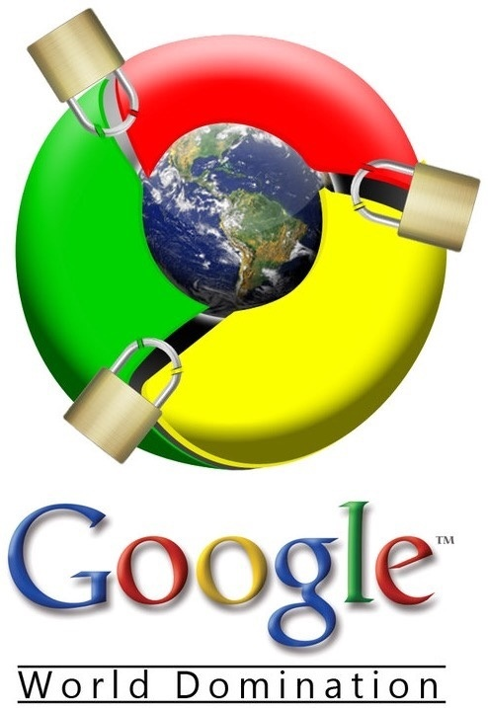
Limitation: Role of Elites
Matthew Hidman (The Myth of Digital Democracy)
Shows that while the Internet has increased some forms of political participation and transformed how interest groups and candidates operate, elites still strongly shape how political material on the Web is presented and accessed
The three major exclusionary mechanisms include: the internet link structure that takes people to a narrow group of popular, mainly commercial, websites (as a consequence of the link structure following a power law distribution that encourages individuals to assess sites which have accumulated the most links); the concentrated economic power of a few leading, privatized companies (Google, Yahoo!, Microsoft) that handle the majority of search requests amidst low regulation; and the social hierarchies that have emerged in the online era that privilege the voices of mostly white, educated, men (131-133).
While citizens have a platform to voice their concerns online, their political speech is often lost in the Internet, because its’ structure is not egalitarian (17).

Slide 42
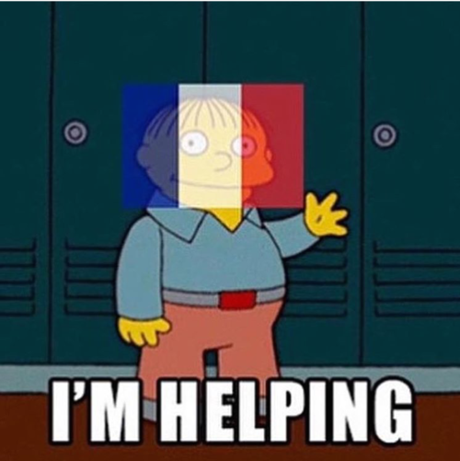
Limitation: Slacktivism
Evgeny Morozov instigated a discussion concerning the phenomenon of slacktivism when he commented on the phenomenon of simply sharing a message online to raise awareness.
He defines slacktivist phenomenon as the “unrealistic assumption that, given enough awareness, all problems are solvable; or, in the language of computer geeks, given enough eyeballs are bugs are shallow” (Morozov, 2009).
For Morozov, this is what drives online campaigns to gather signatures, recruit members to Facebook pages, and to the disseminate links online. While acknowledging that this could be effective for more local issues, larger-scale issues do not benefit from awareness-raising; as he stresses: “at some point one simply needs to learn how to convert awareness into action – and this is where tools like Twitter and Facebook prove much less useful” (Ibid). Critical to the ineffectiveness of online campaigns, according to Morozov, is that they lack clear goals or agendas beyond awareness raising.
Notes:
Morozov, Evgeny. “From Slacktivism to Activism.” http://foreignpolicy.com/2009/09/05/from-slacktivism-to-activism/

Slide 43


Slide 44
Limitation: Slacktivism
The Mission of rabble.ca is to “…draw on the real energy and power of the Internet -- passionate, engaged human beings. Blurring the line between readers and contributors, it will provide a needed space for issues to be discussed, a place to explore political passions and an opportunity to expand ideas."
Visit the following website:
http://rabble.ca/toolkit/3-minute-action and browse some of the links.
What do you think about the 3 minute action causes ?
Notes:
Source of mission statement: http://rabble.ca/about/journalistic-policy

Slide 45
Limitation: Slacktivism
The author of “Political Activism on the Internet: Slacktivism or political participation by other means?”, Henrik Serup Christensen, concludes that “Although most Internet users or slacktivists never develop deeper forms of involvement, there is no evidence that Internet activities are damaging civic engagement by replacing more effective forms of participation.” Do you agree?

Slide 46
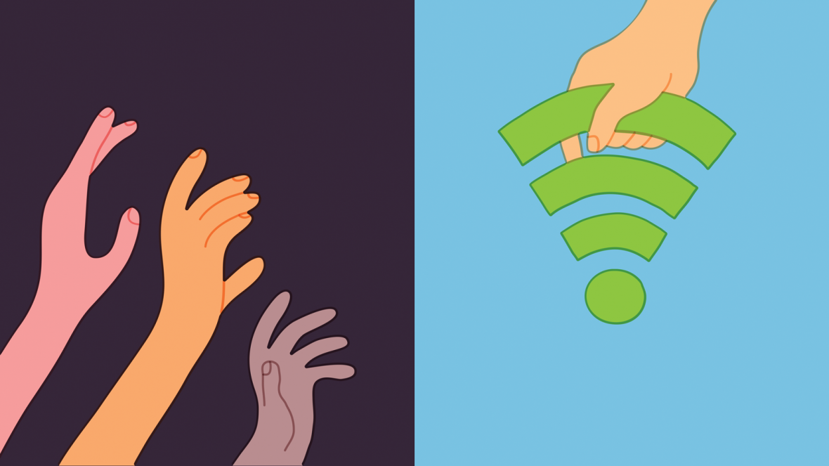
Limitation: Digital Divide
Pippa Norris provides that the term ‘digital divide’ is, “shorthand for any and every disparity within the online community” (4).
Norris conceptualizes three ways in which the digital divide may manifest: the ‘global divide’, the ‘social divide’, and the ‘democratic divide’.
The ‘global divide’ refers to the fact that uneven economic development around the world means that many regions are unable to connect to the Internet; Norris suggests that leaving the world partially wired is of grave concern, as it maintains the economic growth and productivity of wealthier regions and limiting the growth of poorer ones (234).
The ‘social divide’ concerns the fact that socio-economic stratification prohibits complete accessibility to the online (Ibid).
Finally, there is the ‘democratic divide’, which concerns more of a theoretical debate between ‘cyber-optimists’ and ‘cyber-pessimists’ concerning the potential for the internet to facilitate democratic engagement (236). What is valuable in this notion is that it raises attention to the fact that participation in online activities is not accessible to all, therefore, it is not possible for all to engage.
Notes:
Norris, Pippa. Digital Divide: Civic Engagement, Information Poverty, and the Internet Worldwide. Cambridge University Press, 2001.

Slide 47
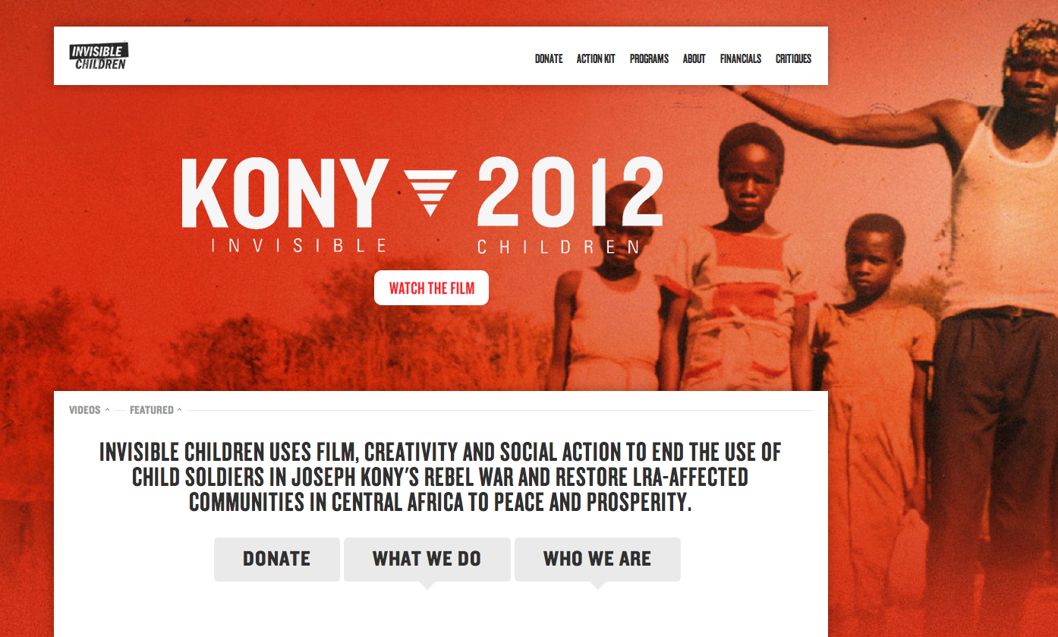
Notes:
Link in photo

Slide 48
Lessons from Kony 2012
“It taught a generation of would-be activists some hard lessons—chiefly, that activism that begins and ends with social media posts (posting an ice bucket video, changing a profile photo to the Human Rights Campaign logo) performs more good for the doer than the cause. It tells your social network that you did this thing; you believe this thing; you are a charitable, good-hearted, aware human being, just like all of your friends who’ve posted the same exact thing. It’s activism so quick and easy that you don’t need to know much about the cause to join in, just a modicum of trust in the friend who posted it first. But when the target of a social media–driven campaign turns out to be far more complex than a prechewed nugget of share-bait suggested, those impassioned messages to Ban Ki-moon that linger on your Twitter timeline might become a source of shame. That shame may have turned some of Invisible Children’s young idealists into cynics. But it taught others how to harness the power of the web for good—and how to do it responsibly.” - Christina Cauterucci, Slate.com
Notes:
http://www.slate.com/articles/news_and_politics/the_next_20/2016/09/kony_2012_quickly_became_a_punch_line_but_what_if_it_did_more_good_than.html

Slide 49
Lessons from Kony 2012
“Thanks in part to Kony 2012, a hashtag can be a legitimate motivating force behind an identity group; the Black Lives Matter movement took the energy and unity a hashtag campaign can inspire and channeled it into activism informed by the people whose struggles inspired it, people who’d been traditionally left out of popular discourse about their own lives. In the case of Black Lives Matter, a hashtag became a statement of group membership and eventually turned into a movement that’s changing conversations about race in the halls of power.” - Christina Cauterucci, Slate
Notes:
http://www.slate.com/articles/news_and_politics/the_next_20/2016/09/kony_2012_quickly_became_a_punch_line_but_what_if_it_did_more_good_than.html

Slide 50
Discussion
Is social media a catalyst for change? Would change occur without it?
Are online activists unwilling to get their hands dirty and do the efforts required to actually achieve these goals?
Does online activism replace or increase offline activism?

Slide 51
Lecture 9: Social Media and Civic Engagement
In this lesson, we have:
Described the intersection of media technologies with activist movements, as well as specific forms of participatory culture that have transpired since the advent of social media
Discussed the role of social media in activist movements, and the re-configuring of social media like Facebook, Twitter, and Youtube for activist use

Slide 52
For next week:
Next week’s class (July 26th) will be online!
Lecture material will be made available online and must be read before class
Ensure you post one tweet and two replies on Twitter before our next meeting on the topic of Social Media and Civic Engagement
Mini-lesson #3: The reading material for the mini-lesson will be made available online and must be read by July 25th. By July 25th, students must respond to one writing prompt, and must reply to one of their classmates’ posts.
Note! Social Media Transformation due on via e-mail BEFORE 7pm, August 2nd .

